Slide 1




Your Group
EMPLOYEE PERFORMANCE ANALYSIS
Presented by:-
Ishan Gupta
Harsh Gupta

Slide 2

﻿About The Project
The objective of this project was to develop a trained model that can predict employee performance rating based on input parameters, and to offer suggestions for raising employee performance based on analysis-derived insights. . The project used a dataset of 1200 employees with 28 features, including a mix of quantitative and qualitative data. The target variable was employee performance rating, which is an ordinal data.

Slide 3
Features
Categorical Features
Numerical Features
Ordinal Features
Target Variable
EmpNumber
Gender
EducationBackground
MaritalStatus
EmpDepartment
EmpJobRole
BusinessTravelFrequency
OverTime
Attrition
Age
DistanceFromHome
EmpHourlyRate
NumCompaniesWorked
EmpLastSalaryHikePercent
TotalWorkExperienceInYears
TrainingTimesLastYear
ExperienceYearsAtThisCompany
ExperienceYearsInCurrentRole
YearsSinceLastPromotion
YearsWithCurrManager
EmpEducationLevel
EmpEnvironmentSatisfaction
EmpJobInvolvement
EmpJobLevel
EmpJobSatisfaction
EmpRelationshipSatisfaction
EmpWorkLifeBalance
PerformanceRating
Performance Rating

Slide 4
Steps Involved in Data Analysis
Data Collection: The data was given from the IABAC for this project..
Data Cleaning: Checking for null values, unimportant features and outliers and removing them.
Data Analysis: Using Python libraries, such as Pandas and NumPy, to perform exploratory data analysis to identify patterns and trends in employee performance.
Data Visualization: Using Python libraries like Matplotlib, Seaborn, or Plotly to create visually engaging charts, graphs, and dashboards to represent the analyzed data.
Interactive Dashboard: Creating interactive dashboards for enabling users to explore the data and gain insights through user-friendly interfaces.

Slide 5

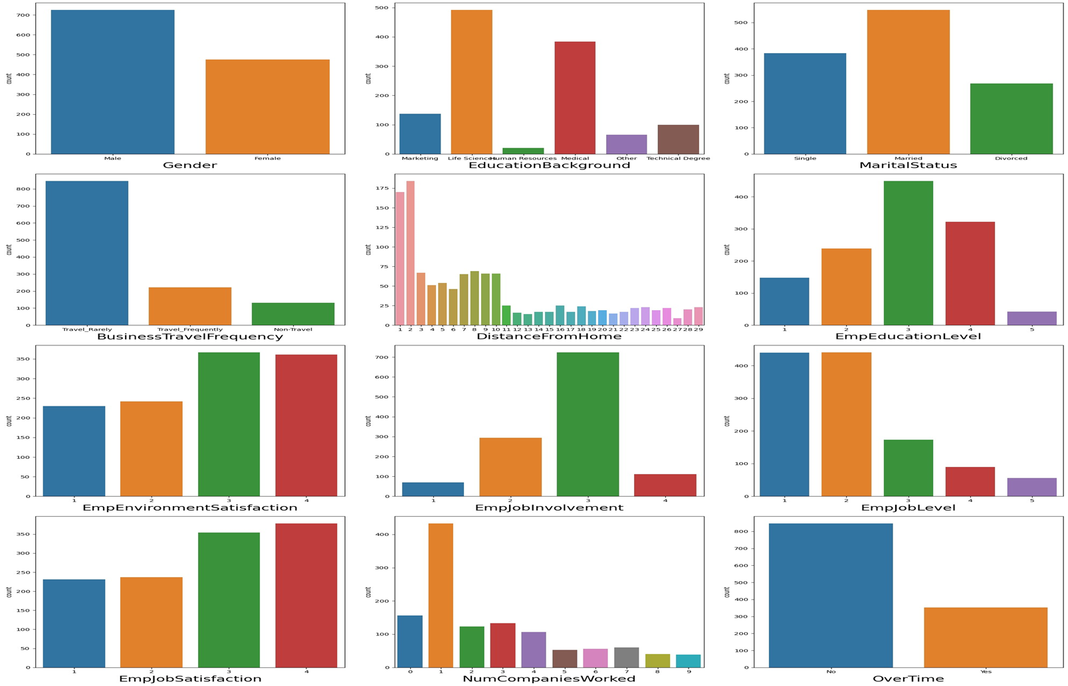
Univariate Analysis

Slide 6
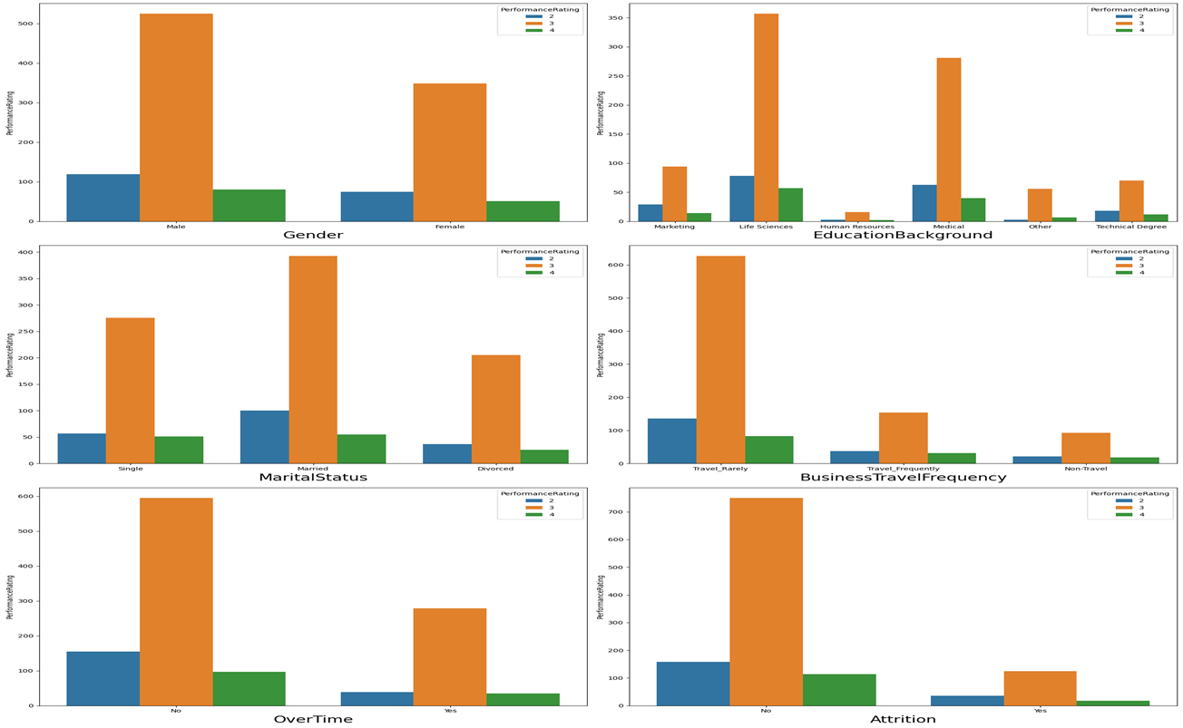
Bivariate Analysis

Slide 7
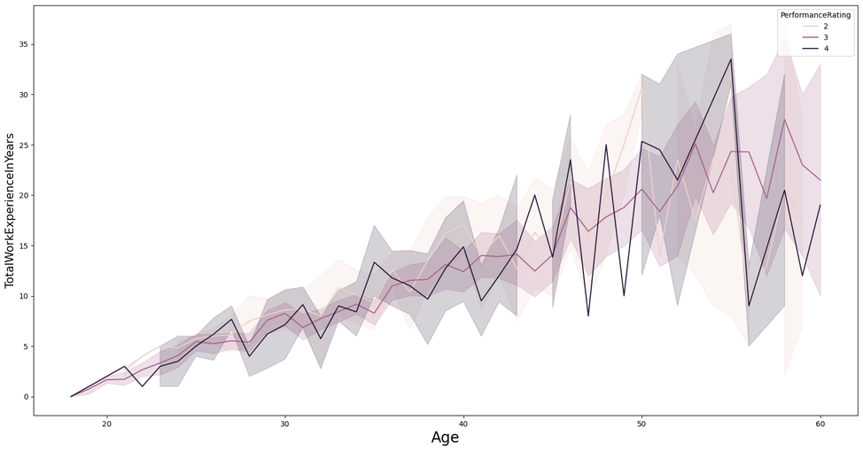
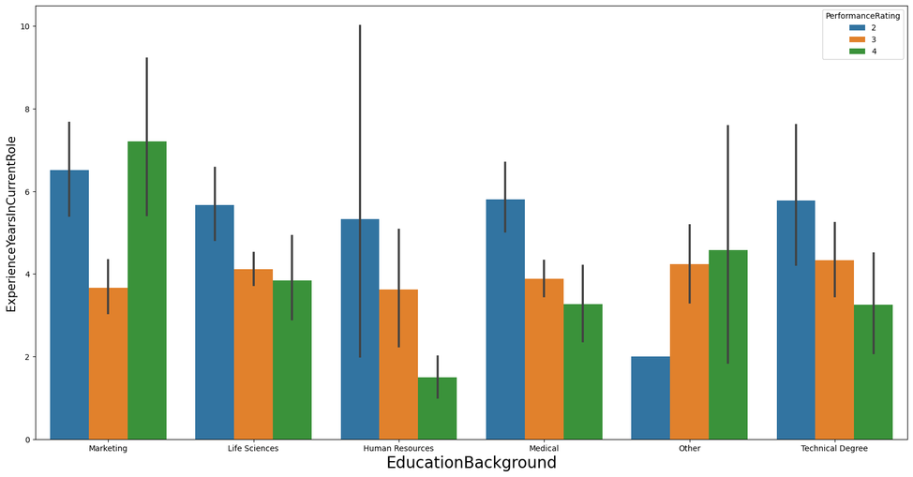
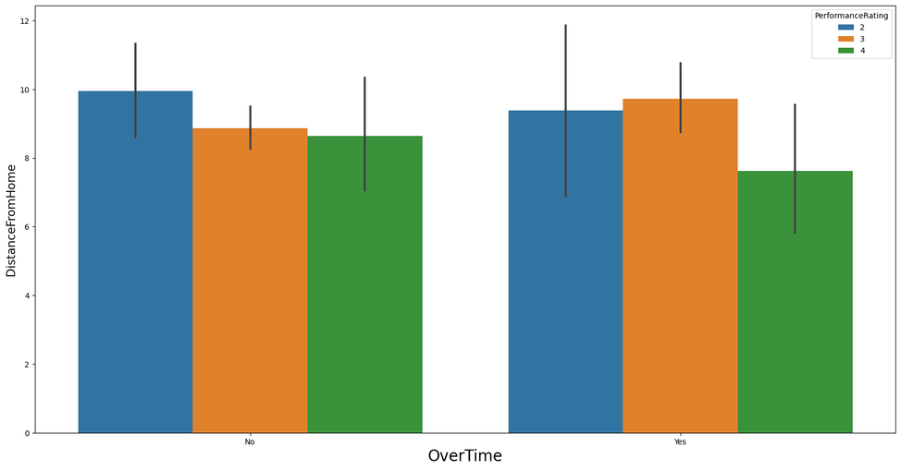
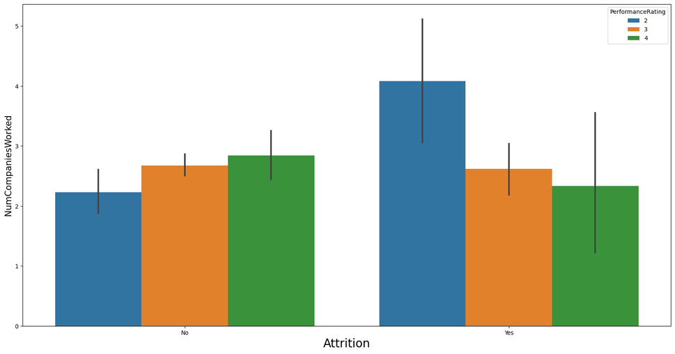
Multivariate Analysis

Slide 8
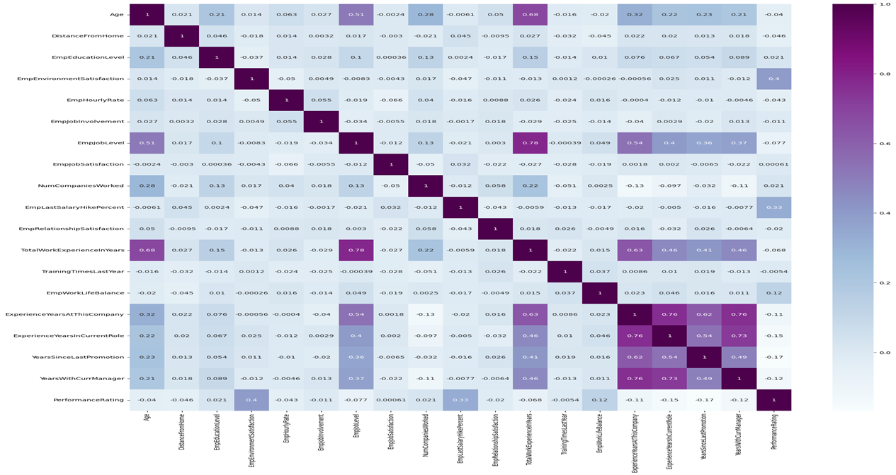
Correlational Analysis

Slide 9
Your Group
﻿THANK YOU

